Slide 1
Representing a multiplicative relationship
Understanding multiplicative relationships: fractions and ratio

Slide 2
how to use Oak lessons

Slide 3
I can use a double number line to represent a multiplicative relationship and connect to other known representations.

Slide 4
Proportionality means when variables are in proportion if they have a constant multiplicative relationship.
A ratio shows the relative sizes of 2 or more values and allows you to compare a part with another part in a whole.

Slide 5

Representing a multiplicative relationship
Using double number lines
Graphical representations

Slide 6

Using double number lines
There are lots of different ways to represent a ratio.
For example, how many different ways can you represent this ratio:
“For every 1 star, there are 3 hearts.”
Ratio table
Bar model
Fraction
Stars | Hearts
1 | 3
☆ | ♡ | ♡ | ♡
are stars
Here are just a few, all illustrating the same ratio.

Slide 7
Using double number lines
Another way to show a ratio is using a double number line.
When drawing the scaled number lines, both lines must start from zero to illustrate the proportionality.
“For every 1 star, there are 3 hearts.”
Ratio table
2
3
Ratio table
1
Stars | Hearts
1 | 3
Star(s)
Heart(s)
3
6
9

Slide 8


Using double number lines
Here is a bar model showing a ratio.
Which double number line shows the above ratio?
What ratio do the other double number lines show?
🔴 | X | X
1
2
3
1
2
3
2
4
6
R
R
R
C
C
C
3
6
9
2
4
6
1
2
3

Slide 9
Using double number lines
🔴
X | X | X
🔴
X | X
🔴 | X
X
1
2
3
1
2
3
2
4
6
R
R
R
C
C
C
3
6
9
2
4
6
1
2
3

Slide 10
Using double number lines
Fill in the blanks.
“For every 2 red, there are 5 green.”
Ratio table
4
6
Ratio table
2
Red(s) | Green(s)
2 | 5
Red(s)
Green(s)
5
10
15

Slide 11
Using double number lines
Lucas is given this ratio table and draws a double number line.
2
3
4
A | B
2 | 11
A
B
11
12
13
Where did Lucas make his mistakes?
Each line must start from 0 and the scale for each line must be consistent.
He has added 1 to each part. Ratio is multiplicative, not additive.
Draw the correct double number line of the ratio given.

Slide 12
Using double number lines
Lucas is given this ratio table and draws a double number line.
2
4
6
A | B
2 | 11
A
B
11
22
33
For A, using this ratio, we are increasing A 2 each time starting from 0
For B, using this ratio, we are increasing B 11 each time starting from 0

Slide 13
Using double number lines
Here is a double number line converting kg into lbs.
Fill in the blanks
a) Amount in kg × 2.2 = Amount in lbs
b) For every kg, there are 2.2 lbs
c) 40 kg = 88 lbs
Here is a double number line converting £ into $
Fill in the blanks
Amount £ × 1.5 = Amount $
b) For every £1 there are $ 1.5
c) £80 = $ 120
1
2
3
2
4
6
kg
£
lbs
$
2.2
4.4
3.3
3
6
9
2.2 ÷ 1 = 2.2
3 ÷ 2 = 1.5

Slide 14
Using double number lines
Izzy and Laura are going on holiday. Izzy converts her pounds (£) using shop A and Laura uses shop B. Who has the better deal and why?
1
2
3
2
4
6
£ (Pounds)
£ (Pounds)
A
B
₹ (Rupees)
₹ (Rupees)
105
210
315
213
426
639
£2 is on both double number lines.
In shop B you get more Rupees for the £2, so shop B is the better deal.

Slide 15
Using double number lines
Fill in the blanks.
1
2
3
1
2
3
a)
b)
A
A
B
B
4
8
12
3
6
9
A | B
1 | 4
A | B
1 | 3
For every 1 A, there are 4 Bs.
For every 1 A, there are 3 Bs.

Slide 16
Using double number lines
Fill in the blanks.
2
4
6
2
4
6
c)
d)
A
A
B
B
7
14
21
5
10
15
A | B
2 | 7
A | B
2 | 5
For every 1 A, there are 3.5 Bs.
For every 1 A, there are 2.5 Bs.

Slide 17
Using double number lines
12
8
2) Sofia and her dad walk side by side along a straight path. The number of steps are represented by the double number line.
Which line represents Sofia’s steps? Explain how you know.
When Sofia has taken 24 steps, how many steps has dad taken?
Write the ratio of Sofia’s steps to her dads steps.

Slide 18
Using double number lines
3) Here is a double number line.
Aisha says to find a, she is going to do 5 × 1.5
Andeep says he is going to find one quarter of 30.
Do you agree with Aisha or Andeep? Explain.
10
20
30
A
B
5
a

Slide 19
Using double number lines
4) Fill in the blanks.
3
6
9
10
20
30
a)
b)
A
A
B
B
4.5
9
13.5
3
6
9
A | B
3 | 4.5
A | B
10 | 3
For every 1 A, there are 1.5 Bs.
For every 1 A, there are 0.3 Bs.

Slide 20
Using double number lines
Fill in the blanks.
1
2
3
1
2
3
a)
b)
A
A
B
B
4
8
12
3
6
9
A | B
1 | 4
A | B
1 | 3
For every 1 A, there are 4 Bs.
For every 1 A, there are 3 Bs.

Slide 21
Using double number lines
Fill in the blanks.
2
4
6
2
4
6
c)
d)
A
A
B
B
7
14
21
5
10
15
A | B
2 | 7
A | B
2 | 5
For every 1 A, there are 3.5 Bs.
For every 1 A, there are 2.5 Bs.

Slide 22

Using double number lines
12
Sofia
Sofia’s Dad
8
2) Sofia and her dad walk side by side along a straight path. The number of steps are represented by the double number line.
Which line represents Sofia’s steps? Explain how you know.
When Sofia has taken 24 steps, how many steps has dad taken?
Write the ratio of Sofia’s steps to her dads steps.
Sofia must be the top number line as she take more steps compared to her dad.
Doubling the 12 steps for Sofia gives 24 steps, so doubling the 8 gives 16 steps.
12 ÷ 8 = 1.5. For every 1 step Sofia’s Dad makes, Sofia has to do 1.5 steps.
8 ÷ 12 = . For every 1 step Sofia makes, Sofia’s Dad has done of a step.

Slide 23


Using double number lines
3) Here is a double number line.
Aisha says to find a, she is going to do 5 × 1.5
Andeep says he is going to find one quarter of 30.
Do you agree with Aisha or Andeep? Explain.
10
20
30
A
B
5
a
A | B
20 | 5
30
Both are correct.
Representing this in a ratio table.
× 1.5
× 1.5
7.5

Slide 24
Using double number lines
4) Fill in the blanks.
3
6
9
10
20
30
a)
b)
A
A
B
B
4.5
9
13.5
3
6
9
A | B
3 | 4.5
A | B
10 | 3
For every 1 A, there are 1.5 Bs.
For every 1 A, there are 0.3 Bs.

Slide 25
Representing a multiplicative relationship
Using double number lines
Graphical representations

Slide 26
Graphical representations
y
You can represent a ratio on a graph.
For example, the following multiplicative relationship:
6
2
4
6
2
4
6
y
Bar model
Ratio table
2
4
6
y
x | y | y
2
4
6
4
y
y
2
4
6
x | y
1 | 2
2
4
6
y
y
2
2
4
6
2
4
6
y
y
On a double number line:
0
x
1
2
3

Slide 27
Graphical representations
y
You can represent a ratio on a graph.
The line represents all of the points where the ratio is equivalent.
6
4
x | y
1 | 2
x | y
1 | 2
2 | 4
x | y
1 | 2
2 | 4
2.5 | 5
2
There are an infinite number of equivalent ratios.
x
0
1
2
3

Slide 28
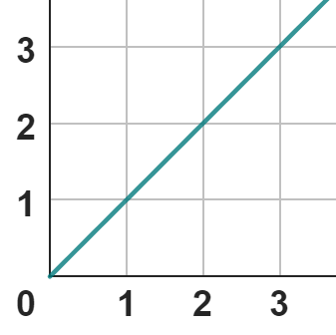
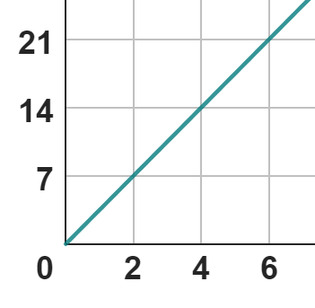


Graphical representations
Jun and Sofia have each represented a ratio graphically.
y
y
Sofia
Jun
x
x
Jun thinks they have both represented the same ratio.
Do you agree with him?

Slide 29
Graphical representations
Jun and Sofia have each represented a ratio graphically.
y
y
Sofia
Jun
x
x
Jun thinks they have both represented the same ratio.
They are different ratios.
You need to pay attention to the scale on the axes.

Slide 30
Graphical representations
Fill in the gaps for the ratio.
y
y
y
3
21
21
2
14
14
1
7
7
0
x
0
0
x
x
1
2
3
2
4
6
2
4
6
For every 1 x, there is 1 y.
For every 2 x, there are 7 y.
For every 1 x, there are 7 y.

Slide 31
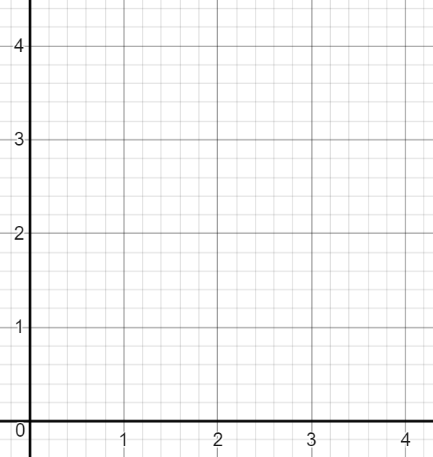
Graphical representations
$
Using the graph, complete the information.
1
2
3
£
$
1.20
2.40
3.60
£ | $
1 | 1.20
£
For every £1, there are $1.20

Slide 32
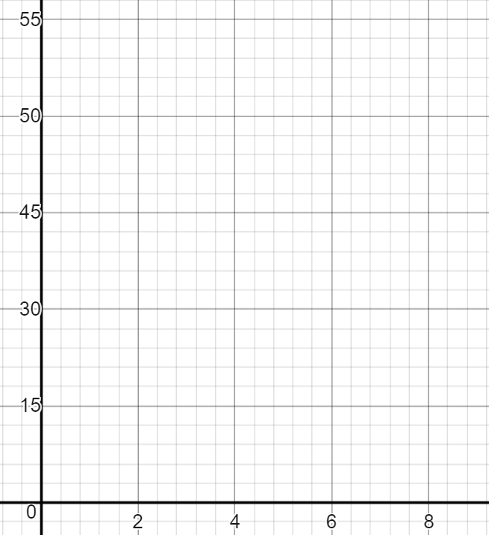
Graphical representations
The graph shows a scale conversion on a map. Using the graph, work out the following:
How many km is 12 cm?
How many cm is 3 km?
km
For every 2 cm on the map, is 15 km
For every 1 cm on the map, is 7.5 km
90 km
cm | km
2 | 15
× 6
× 6
12 | 90
cm

Slide 33
Graphical representations
The graph shows a scale conversion on a map. Using the graph, work out the following:
How many km is 12 cm?
How many cm is 3 km?
km
For every 2 cm on the map, is 15 km
90 km
cm | km
2 | 15
÷ 5
÷ 5
0.4 | 3
0.4 cm
cm

Slide 34
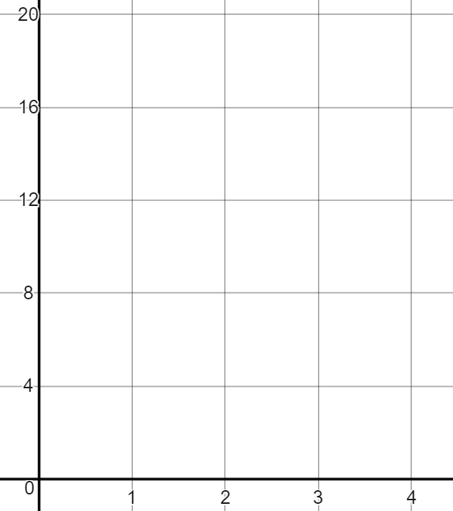
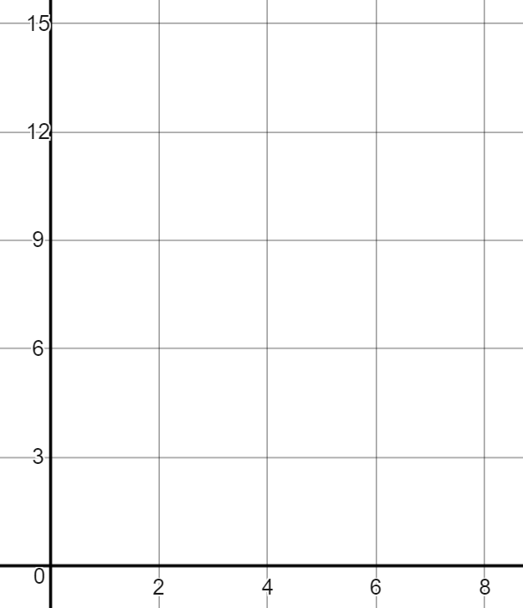
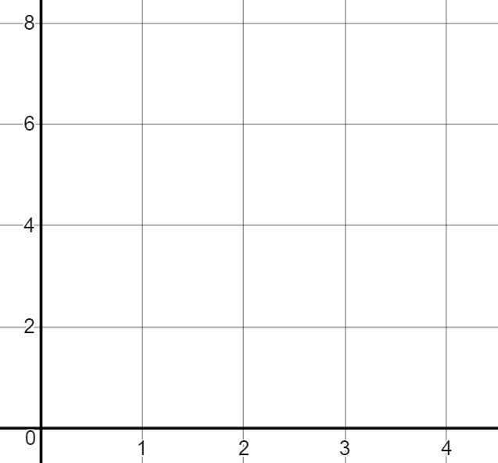
Graphical representations
Fill in the ratio tables using the corresponding graphs.
B
B
B
A
A
A
A | B
1
A | B
1
A | B
2

Slide 35
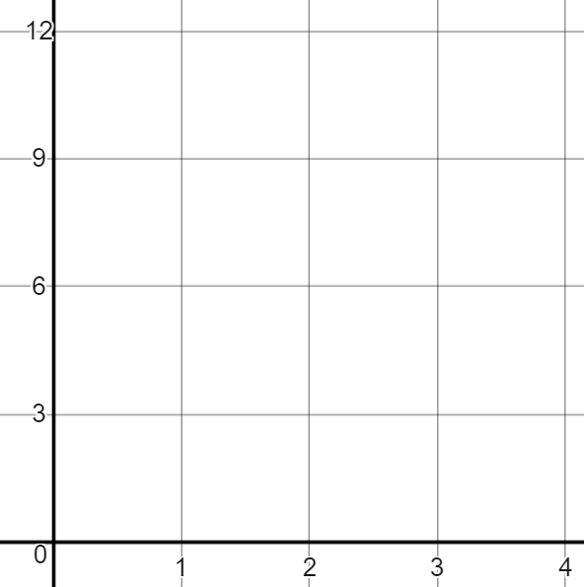
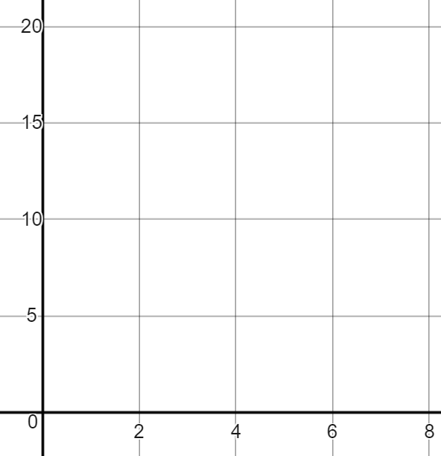
Graphical representations
2) Fill in the missing information on the double number line of graph.
B
B
B
A
A
A
20
30
B
B
B
A
A
A
1
4
6
12

Slide 36
Graphical representations
3) Jacob has interpreted the graph incorrectly.
a) Explain where his mistake is and correctly answer the question.
B
The double number line is
For every 3 As, there is 1 B.
When there are 12 As there are 4 Bs.
3
6
9
A
B
1
2
3
A

Slide 37
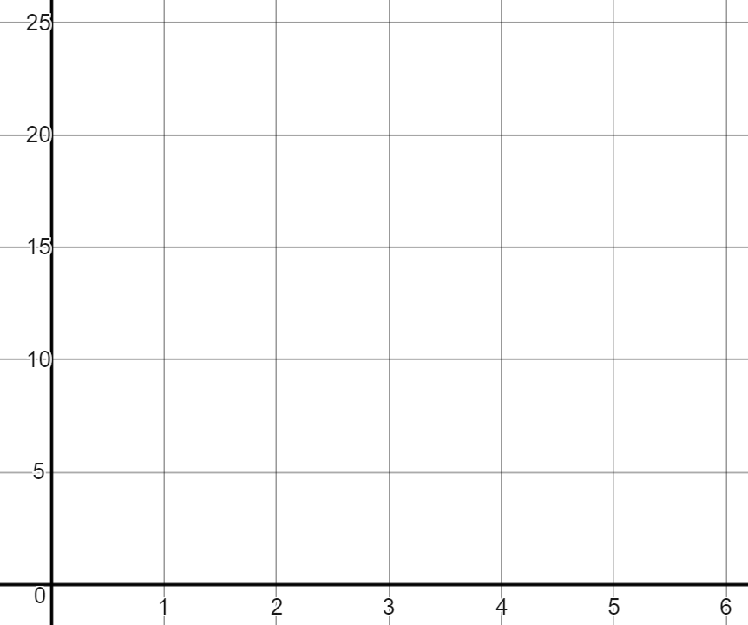
Graphical representations
4) Fill in missing information and graph when a scale drawing on a map states for every ….. cm is …… km in real life.
Work out …….. cm in km
Work out 45 cm in km
Work out ……. km in cm
Answer: 40 km
Answer: 150 km
Answer: 18 cm

Slide 38
Graphical representations
Fill in the ratio tables using the corresponding graphs.
B
B
B
A
A
A
A | B
1
A | B
1 | 2
A | B
1
A | B
1 | 8
A | B
2
A | B
2 | 7.5

Slide 39
Graphical representations
2) Fill in the missing information on the double number line of graph.
B
B
B
A
A
A
3
6
9
3
6
9
10
20
30
B
B
B
A
A
A
1
2
3
2
4
6
4
8
12

Slide 40
Graphical representations
3) Jacob has interpreted the graph incorrectly.
a) Explain where his mistake is and correctly answer the question.
B
The double number line is
For every 3 As, there is 1 B.
When there are 12 As there are 4 Bs.
3
6
9
A
B
1
2
3
A
Jacob’s double number line has B as the x axis and A as the y axis.

Slide 41
Graphical representations
The correct double number line is:
B
3
6
9
B
A
1
2
3
For every 3 As, there are 9 Bs
A
For every 1 A, there are 3 Bs

Slide 42
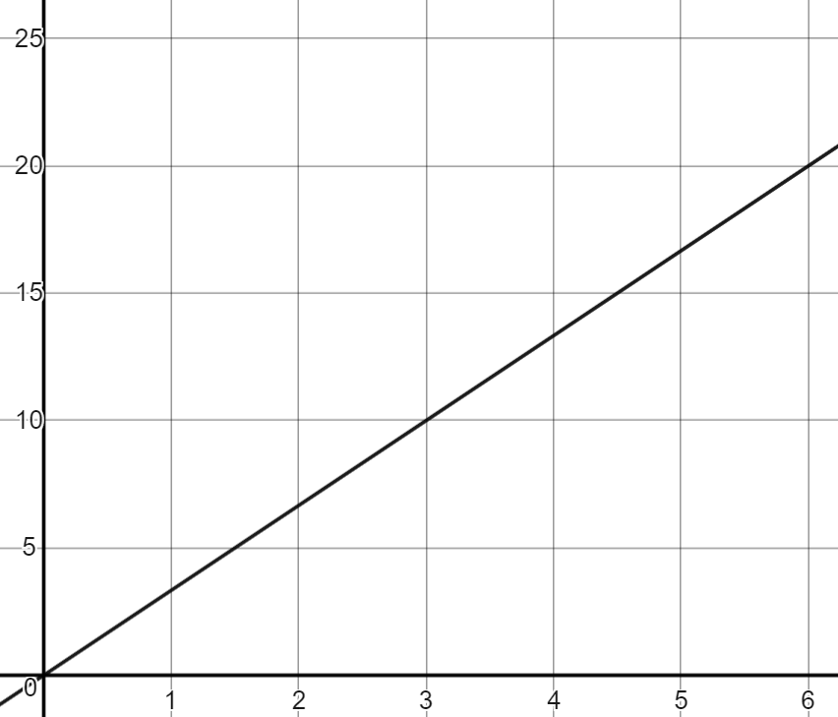
Graphical representations
km
4) Fill in missing information and graph when a scale drawing on a map states for every 3 cm is 10 km in real life.
Work out 12 cm in km
Work out 45 cm in km
Work out 60 km in cm
Answer: 40 km
cm
÷ 15
3 cm for every 10 km
Answer: 150 km
Answer: 18 cm

Slide 43
Representing a multiplicative relationship
Proportionality means when variables are in proportion if they have a constant multiplicative relationship.
There are lots of different ways to represent a ratio: bar models, ratio tables, double number lines and graphs to name some examples.
What is important is understanding how the same ratio can be represented in lots of these different ways.

Slide 44

© Oak National Academy 2023.
Produced in partnership with Mathematics in Education and Industry.
Licensed on the Open Government Licence v3.0, except where otherwise stated. See Oak terms and conditions.

